Slide 1
Animal Bites – Data Analysis

Slide 2
Questions asked - Analysis
Is there any null values? If yes then how much?
What are the animals involved in it?
Which animal bites the human most?
Dog bites are more as per the data. So need to look for which dog breed involved more?
Now it’s time to look for the gender?

Slide 3
Questions asked - Analysis
Take the count of dog bites in each year?
Take the count of dog bites in each month?
Look for the results of rabies spread on which gender?
Look for the data where it attacked Head or Body.
Start looking for the cats bites with gender specification

Slide 4
Trends Analyzed
From the data, Dogs are involved more in bites
Next position is taken by Cats.
In the dog breeds, pit bull impacted more bites on human.
Male dogs are involved more in bites.
Dog bites are more in April to August.

Slide 5
Trends Analyzed
Rabies are caused due to the unknown breeds.
Male cats are involved more in bites.
Cat bites are more in June to August.
Apart from Dog and Cat, Bats attacked human more.

Slide 6
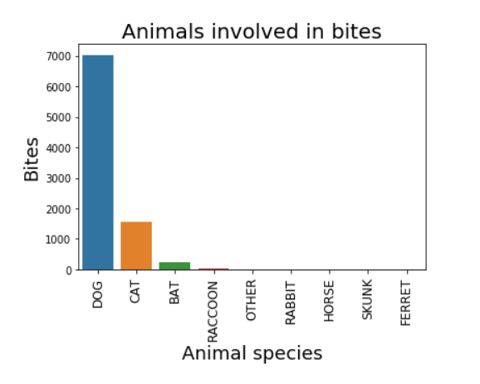
Visualizations

Slide 7
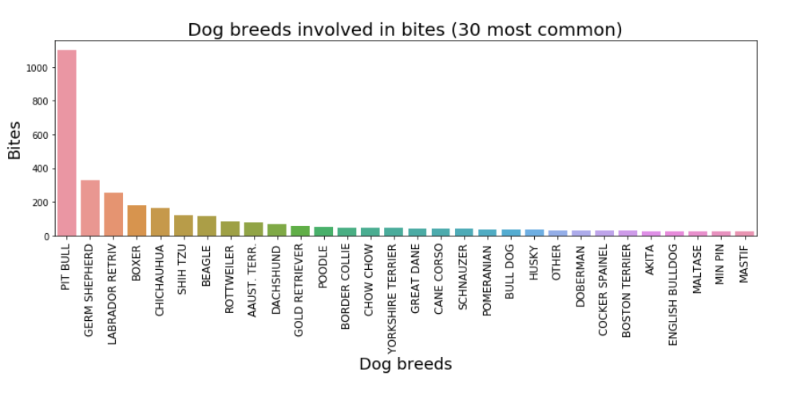
Visualizations

Slide 8
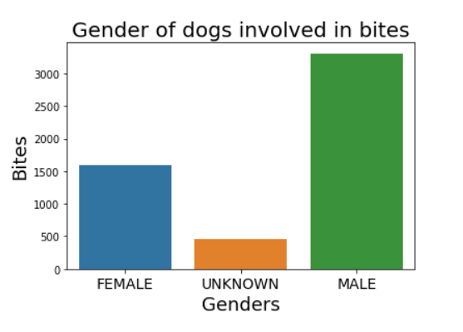
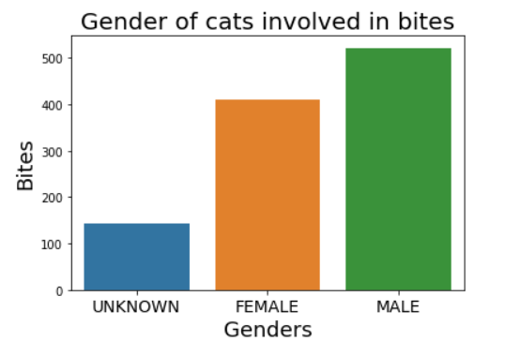
Dogs vs Cats - Gender

Slide 9
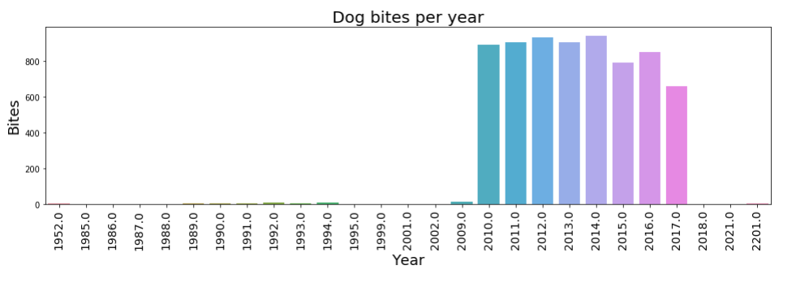
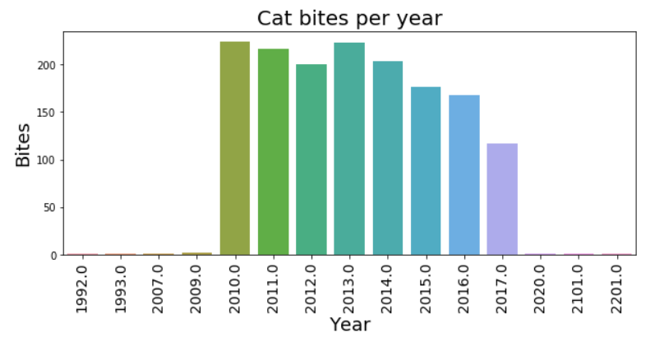
Dogs vs Cats Bites - Year

Slide 10
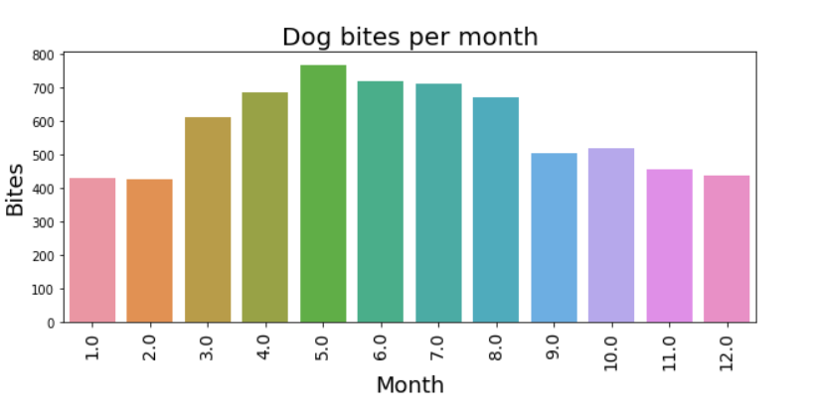
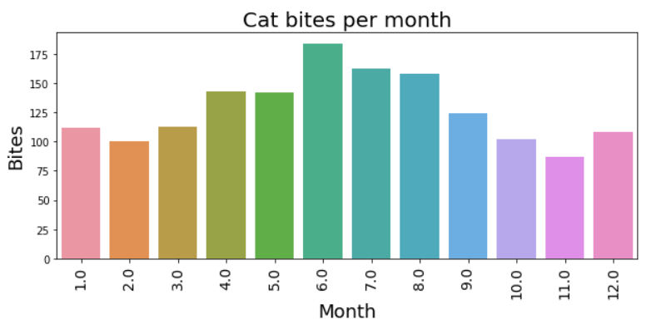
Dogs vs Cats Bites - Month

Slide 11
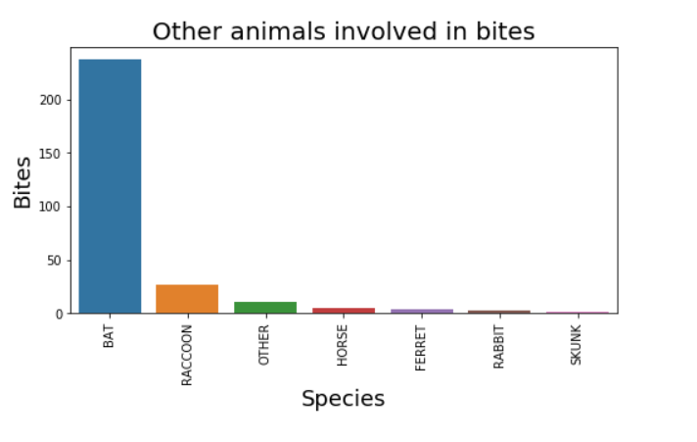
Other Species - Bites

